Slide 1

NTT DATA's Proposed Approach for Observability & Telemetry
January 2025

Slide 2

NTT DATA’s Observability & Telemetry CoE
At NTT DATA, we offer a comprehensive portfolio of observability and monitoring related services designed to meet the diverse needs of our clients. Our commitment to innovation and customer satisfaction sets us apart in the market, providing tangible benefits that extend beyond the norm. Leveraging cutting-edge technologies and industry expertise, NTT empowers clients to gain invaluable insights into their operations, driving informed decision-making and enhancing overall efficiency.

Slide 3
Observability value stream
DATA COLLECTION
DATA STORING, FORWARDING AND RETENTION
DATA PROCESSING
EFFECTIVE USE OF THE DATA
ACTIONS
IF…
- NO DATA IS COLLECTED,
- THE COLLECTED DATA IS NOT STORED AND NOT FORWARDED,
- THE DATA IS NOT PROCESSED, CLASSIFIED, ENRICHED, CORRELATED,
- THE PROCESSED DATA IS NOT USED EFFECTIVELY,
- THE RELEVANT PEOPLE CAN’T ACCESS TO THE RESULTS,
- NO ACTIONS ARE TAKEN BASED ON THE INSIGHTS,
THEN THERE IS NO OBSERVABILITY.

Slide 4
Observability Maturity Framework
LEVEL 4
NPM | Network Performance Management
APM | Application Performance Management
DEM | Digital Experience Management
AIOps | Artificial Intelligence for Operations
AIPA | Artificial Intelligence Predictive Analytics
CM | Continuous Management
LEVEL 3
Predictive
Proactive
LEVEL 2
Reactive Monitoring
Log
Analytics
DEM
LEVEL 1
APM
Component Monitoring
CM
NPM
AIPA
AI Ops
LEVEL 0
Database
Hope & Pray
Network
Infrastructure
Maturity Level
Server Infrastructure
Ping
No Monitoring
Component monitoring
Observability

Slide 5







Our view of Telemetry
ServiceNow: Service Management
ITSI: AIOPs
CSDM:IBS
CMDB: Enrichment
Data
Contextualisation and Normalisation
Trivial
Intelligent Incidents & MIMs
Events
Alert clustering and root cause analysis
Logs
Cloud
Essential
Alert - CI binding
Applications
Incidents
Databases
Any Source
Unified Observability Dashboards
Containers
Critical
Incident Generation
Servers
CMDB/CSDM: CI Data
Automation
Storage
Traces
Metrics
Engineering
DevOps
Operations
IRIS
Support
Regulators
Management

Slide 6
NTT DATA experience with Leading Global Bank
Requirements:
Standardise monitoring and consolidate tools for consistent views and enable event predictability
Improve incident analysis and siloed automation initiatives
Establish end-to-end monitoring with a SPoG view
Work on framework to manage, measure ROI & implement automation.
1
Set up Operating Model
2
Standardisation of Monitoring Tools
To operationalise automation, upskill, cross skill and train resources in tools and technology
Set up standardised frameworks in Splunk and App Dynamics
Wholesale
3
Designing of Service Catalogue
A core document connecting Region-> Payment Flow-> Application -> Components
4
Defining Key Matrix
Implementing of Automation Use Cases
5
Determine thresholds to gauge the component and application health
Defined processes to generate book of work and qualify for ROI
Requirements:
Prioritise alerts based on customer impact, regulatory impact and critical factors
Improve service reliability of SRE function to be more agile and proactive
Enhance speed and efficiency in identifying root cause of issues
Develop a clear future roadmap for API production support aligned with industry trends for SRE function
1
API Monitoring & Tools
2
E2E API Functional Platform
Review tools and technology in place to support API management process
Assess overall operational processes in place and implemented the E2E API functional platform
WPB
3
WPB API Platform
Assess WPB-API Platform from telemetry, monitoring, production scaling and production support aspect
4
API Implementation Controls
5
API Adoption & Config. Methods
Including circuit breaker, backoff, retry, throttling, rate limiting, quota patterns and noisy neighbor protection
Including the developer portal, CI/CD process and change management (including testing) and versioning

Slide 7

NTT DATA’s Proposed Approach for AIB

Slide 8


NTT DATA’s Proposed Approach for AIB
Potential set of challenges
Difficulty in identifying and diagnosing system issues quickly.
High costs associated with downtime or performance degradation.
Complexity in managing multiple monitoring tools.
Lack of visibility into system performance across different environments.
Overwhelmed by the volume of alerts.
Based on this understanding, NTT DATA has proposed the following
NTT DATA are proposing a consulting engagement on Observability with the output being a documented Strategy and Executive plan
The focus area will be on the following aspects:
Proactive monitoring to minimize impact on users.
Performance reports which will aid in informing business decisions.
What cost savings can be deduced from reduced downtime and optimized resource usage.
Custom dashboards and visualization tools to assist with better insights.
Recommendations on Observability Tools Rationalization
How can AIOps and automations be utilized to decrease alert fatigue and repetitive tasks
Engagement Lead
Observability Lead
Telemetry Lead
Business Analysts
Offshore
On/ near-shore
Notes:
How many story points can be delivered by each squad based on prior experience? 30min, 35max why 10 per squad? – that’s what we have seen working with other clients
3 additional roles -> Experienced on executing similar scale projects, bring in best practices, Integrating the new squads with other squads

Slide 9

Project scope (What we will do)
NTT DATA will use the existing knowledge base within the bank to understand E2E customer journey and the underlying technology components (application and infrastructure) that enable the journey
NTT DATA will work with AIB teams to establish/validate or create meaningful SLO’s which would indicate the normal “good” performance of the applications across the customer journey and service chain maps.
NTT DATA will identify any gaps in signaling (tracing, logging and metrics) for technology components.
NTT DATA will work with the required AIB teams to define standards for signaling.
NTT DATA will provide recommendations to AIB teams to normalise the telemetry data (standards).
NTT DATA will integrate (recommend) the available signaling, event, metric and logging data into the appropriate Service Level Indicators (SLI’s) as per the outlined solution
NTT DATA will provide dashboarding recommendations to AIB administrators to visualize end-to-end observability of the user journey, with a top-level focus of an outage or performance issue that is critical to the normal function of that user journey or feeding an upstream or downstream user journey.
NTT DATA will provide the requirements of dashboarding of traces and trace spans to allow identification of where the technology components are failing.

Slide 10
Project Plan & Deliverables
W 1
W2
W 3
W 4
W 5
W 6
W 7
W 8
W 9
W 10
W 11
Deliverables
Key Activities
Ratification deck
Team Onboarded
Scope Finalised
Access to AIB documents
Engagement
Identify stakeholders and business drivers
Identify initial goals and assessments
Define expected outcomes
Create effort estimation and project timeline
Kick-off meeting
Stakeholder Workshops
RACI Matrix
Status meetings
Plan
Assemble project team
Define status meetings and agree on communications
Identify stakeholders
Schedule workshops
Conduct workshops
To-be capability
Value Stream Mapping
Strategy alignment
Infrastructure, network, application monitoring
Discover - Analyse
CMDB
Processes
Create as-is motivation view and app-tech layered view
Create to-be motivation view and capability view
Solution Architectures
Heat Maps
Gap & TCO Analysis
Roadmap
Stakeholder Presentation
Validation workshops and improvements
Develop 2 solution architectures that fulfil target state requirements
Create solution analysis (capability heat maps, TCO analysis)
Migration
Recommend
Prepare slide-deck for decision making
Validation workshops and improvements
Create executive slide deck summary
Validation workshops and improvements
© 2025 NTT DATA Inc.

Slide 12
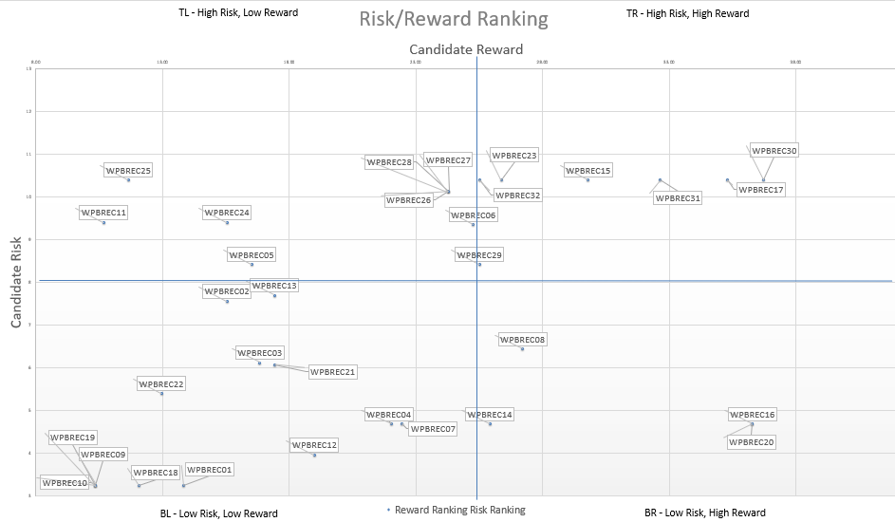

NTT DATA’s Relevant Accelerators
Risk – Reward Matrix
Baseline SRE Metrics
SLI, SLO and Error Budget are crucial components of SRE. They help quantify the performance and reliability of services and set expectations for users and stakeholders. We have defined templates for the metrics (VALET) that can be used for a quick baseline setup.
V=Volume;
A=Availability;
L=Latency;
E=Errors;
T=Tickets
Accelerators
Quick Win Automations
SPoG & Integration
Splunk Configuration Changes
Pipeline that can be integrated to enable a configuration-as-code approach for managing Splunk settings. This streamlines the process of updating and maintaining Splunk configurations.
Certificate Renewal –
Microservice that automates the renewal of certificates hosted on Venafi. The service ensures the timely renewal of certificates and automatically pushes updated certificates to the relevant application repositories.
Single Plane of Glass
Comprehensive observability strategy is necessary for effective SRE. We have predefined dashboards in Grafana (an open-source tool) for SRE that can be reused by importing JSON files
Integration Scripts
We have developed tool-agnostic Python scripts that facilitate connections to various sources, such as Splunk, AppDynamics, InfluxDB, and more, enabling the retrieval of key application performance metrics and data transmission to databases.
Notes:
NTT DATA has an array of accelerators such as:
- Defined templates for Error Budgets and SLIs/SLOs
- Reusable predefined dashboard
- Tool agnostic Python scripts

Slide 13

A leading financial services company
Financial Services Company
Targeted Operating Model
The SRE team was established to cut across all the target operating model functions to perform the following functions:
Conduct design reviews to adhere to non-functional requirements as part of the architectural review board (ARB) to drive compliance
Establish a blameless postmortem culture, learning from failures
Establish optimal branching and build strategy
Coordinate with Build and Run leads to identify an RCA on bottleneck areas
Establish governance framework to track and report KPI
Conduct ongoing assessment for continuous improvement opportunities
Participate in disaster recovery planning
Support tool maintenance, patches, upgrades, customisations/configurations
Maintain environment maps for all supported environments
Manage environment provisioning scripts and playbooks
Provide insights from monitoring logs to identify recurring issues
Amplify customer experience and digitally scale operations to support customers and agents by modernising technology and creating competitive advantage with a “no- touch” data-driven digital experience while levelling YoY IT spend
Address challenges in the support model impacting customer’s ability to best serve their stakeholders
Lack of technology expertise, experience directly impacted application stability/reliability
Created horizontal service reliability engineering (SRE) team to provide 24x7 support across all app domains to focus on:
Technical design to provide input and understand scalability/support requirements
Release and operational support for all services and related components
Enforcement of governance, best practices and promote reusability functions like a center of excellence (CoE)
Consistent build to run transition
Onboarding new services into a continuous integration/continuous deployment (CI/CD) pipeline
Increases application processing capacity from 50K to 250K yearly
Accelerates policy processing from 25 per hour to one every 30 seconds
Eliminates lab work for customer policies that qualify of up to $3M
Reduces expenses by 21% through automated underwriting
Reduces policy delivery time by 50%
Minimises impact to business through proactive synthetic monitoring where issues are caught and addressed before there is an impact
Enforces NFR requirements through a continuous feedback loop, from the production learning to the ARB
Leverage feedback loop and better metrics tracking leading to better design in terms of scalability and extensibility of new services
Generates better quality of released through enhanced metrics and standards
“NTT DATA integrated our solutions into an end-to-end, no-touch process. Their expertise enabled us to accelerate product development and delivery. It used to take a year to deliver a product, but with our partnership we can deliver in less than six months on average — faster than the industry benchmark.”
CIO

Slide 14
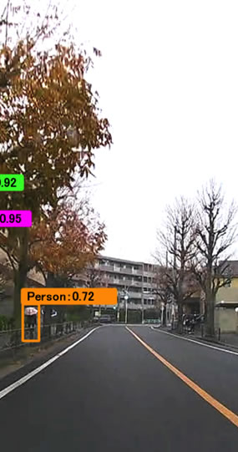
Smart sensor platform SRE POD
Automative, SRE
An automotive software developer, part of global auto manuf. sought a partner to help them stand up a new and modernised public cloud ecosystem to support their fast-paced software development needs.
Complex organisation of legal, tax compliance, cross organisational development teams and external vendors, support their 10,000 users.
Needed a redesigned landing zone, DevOps tooling platform including Git Hub, Jira, Confluence, Artifactory, GitLab, Source Graph and Task Top.
NTT DATA helped our client to realise their vision by starting small from cloud design and implementation to CI/CD and Infrastructure as Code.NTT DATA then partnered with our client to establish a Site Reliability Engineering capability which was staffed by a mix of NTT DATA SRE’s and our client’s personnel.
Infrastructure maintenance and upgrades
Tool Administration
Tool/Platform Support
Monitoring ànd Incident response
User access management
Allowing our client to start small and to grow the capability
Implementation of a full range of services for their developers from infrastructure management and pipeline orchestration to Site Reliability Engineering
Implementation of SRE practices:
Identifying SLI’s and buildingCustom Dashboards
Incident response triage and resolution
Blameless postmortems
Providing toil reducing automation
Supporting end-user requests for CI/CD capacity and infrastructure requirements
Setting best practices for tools usage

Slide 15

Leading European Bank – Site Reliability Engineering
Leading European Bank – Site Reliability Engineering
Array of lower-level tooling monitoring components of services, the lack of consolidated insights is leading to extended recovery times after the issues due to inefficient triage.
Inability to proactively or predictively maintain real time or trend-based insights on quality of service and experience across banks key customer journeys.
Reduce Operational , Transformational, and regulatory risk
E2E Integrity for Payments, Improved SLA Performance & Reduced Incidents, and 360 Health View of Business, App & Infra
Established dedicated COE – Design, dev & support
Advised bank on deciding key KPIs for Real Time Monitoring
Enabled bank in creating workflows in Splunk tool and AI (Predictive Analytics and NLP)
Enabled bank in implementation and support of :
Splunk Dual Cluster to support critical Splunk BAM Integrity Alerts
Splunk ITSI app, OS app, H/F and ML Components
Splunk Multi-Site Resilient Cluster
Proactive monitoring of Mobile App using Splunk ITSI
Predictive Business Service Monitoring
Automated Service Intelligence Platform
Targeted Operating Model
Bank’s Service Insight platform is a leader among global banks and was shortlisted for Award for Best Application of AI in Large Enterprise
Improved customer experience in measuring extracting and analysing vast amounts of data in real time
Converting high and medium incident to low by identifying and resolving it at an early stage
Bank become proactive and predictive
Up to 30% reduction in incidents & MTTR
Automation first approach to incident triage and action.
Multi-disciplined, multi-level Agile Team comprised of domain specialists
A team understanding of the entire application ecosystem
Bank to become proactive and predictive
Leverage predictive and ML capability plus auto correction automation.
Take a true focus on reliability
Up to 30% reduction in incidents & MTTR

Slide 16
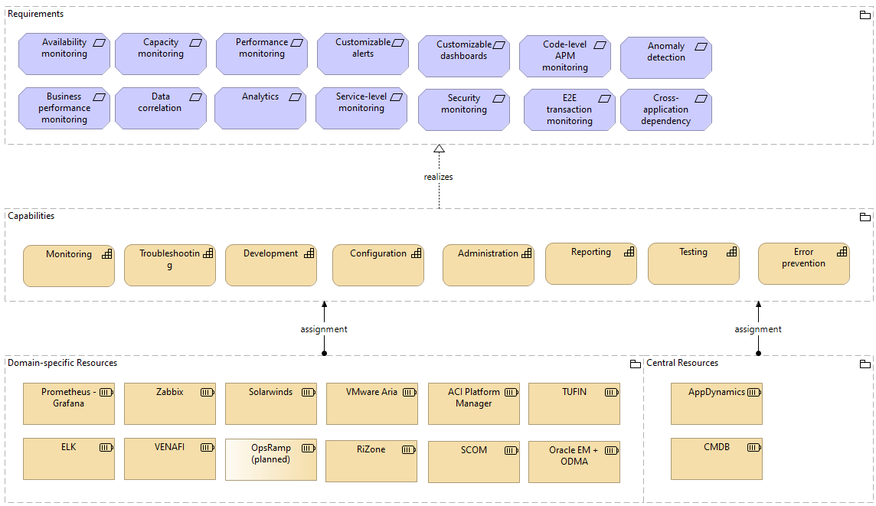
Appendix 1 – Capabilities & resources view example

Slide 17
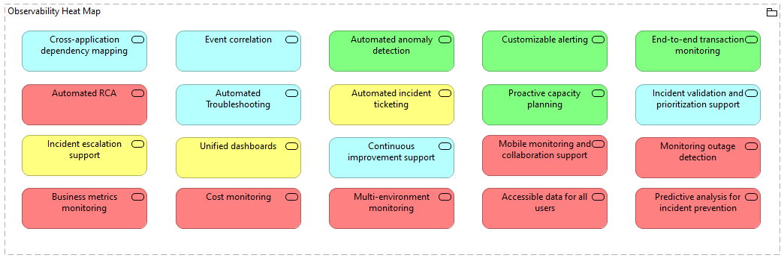
Appendix 2 – Heat map example

Slide 18
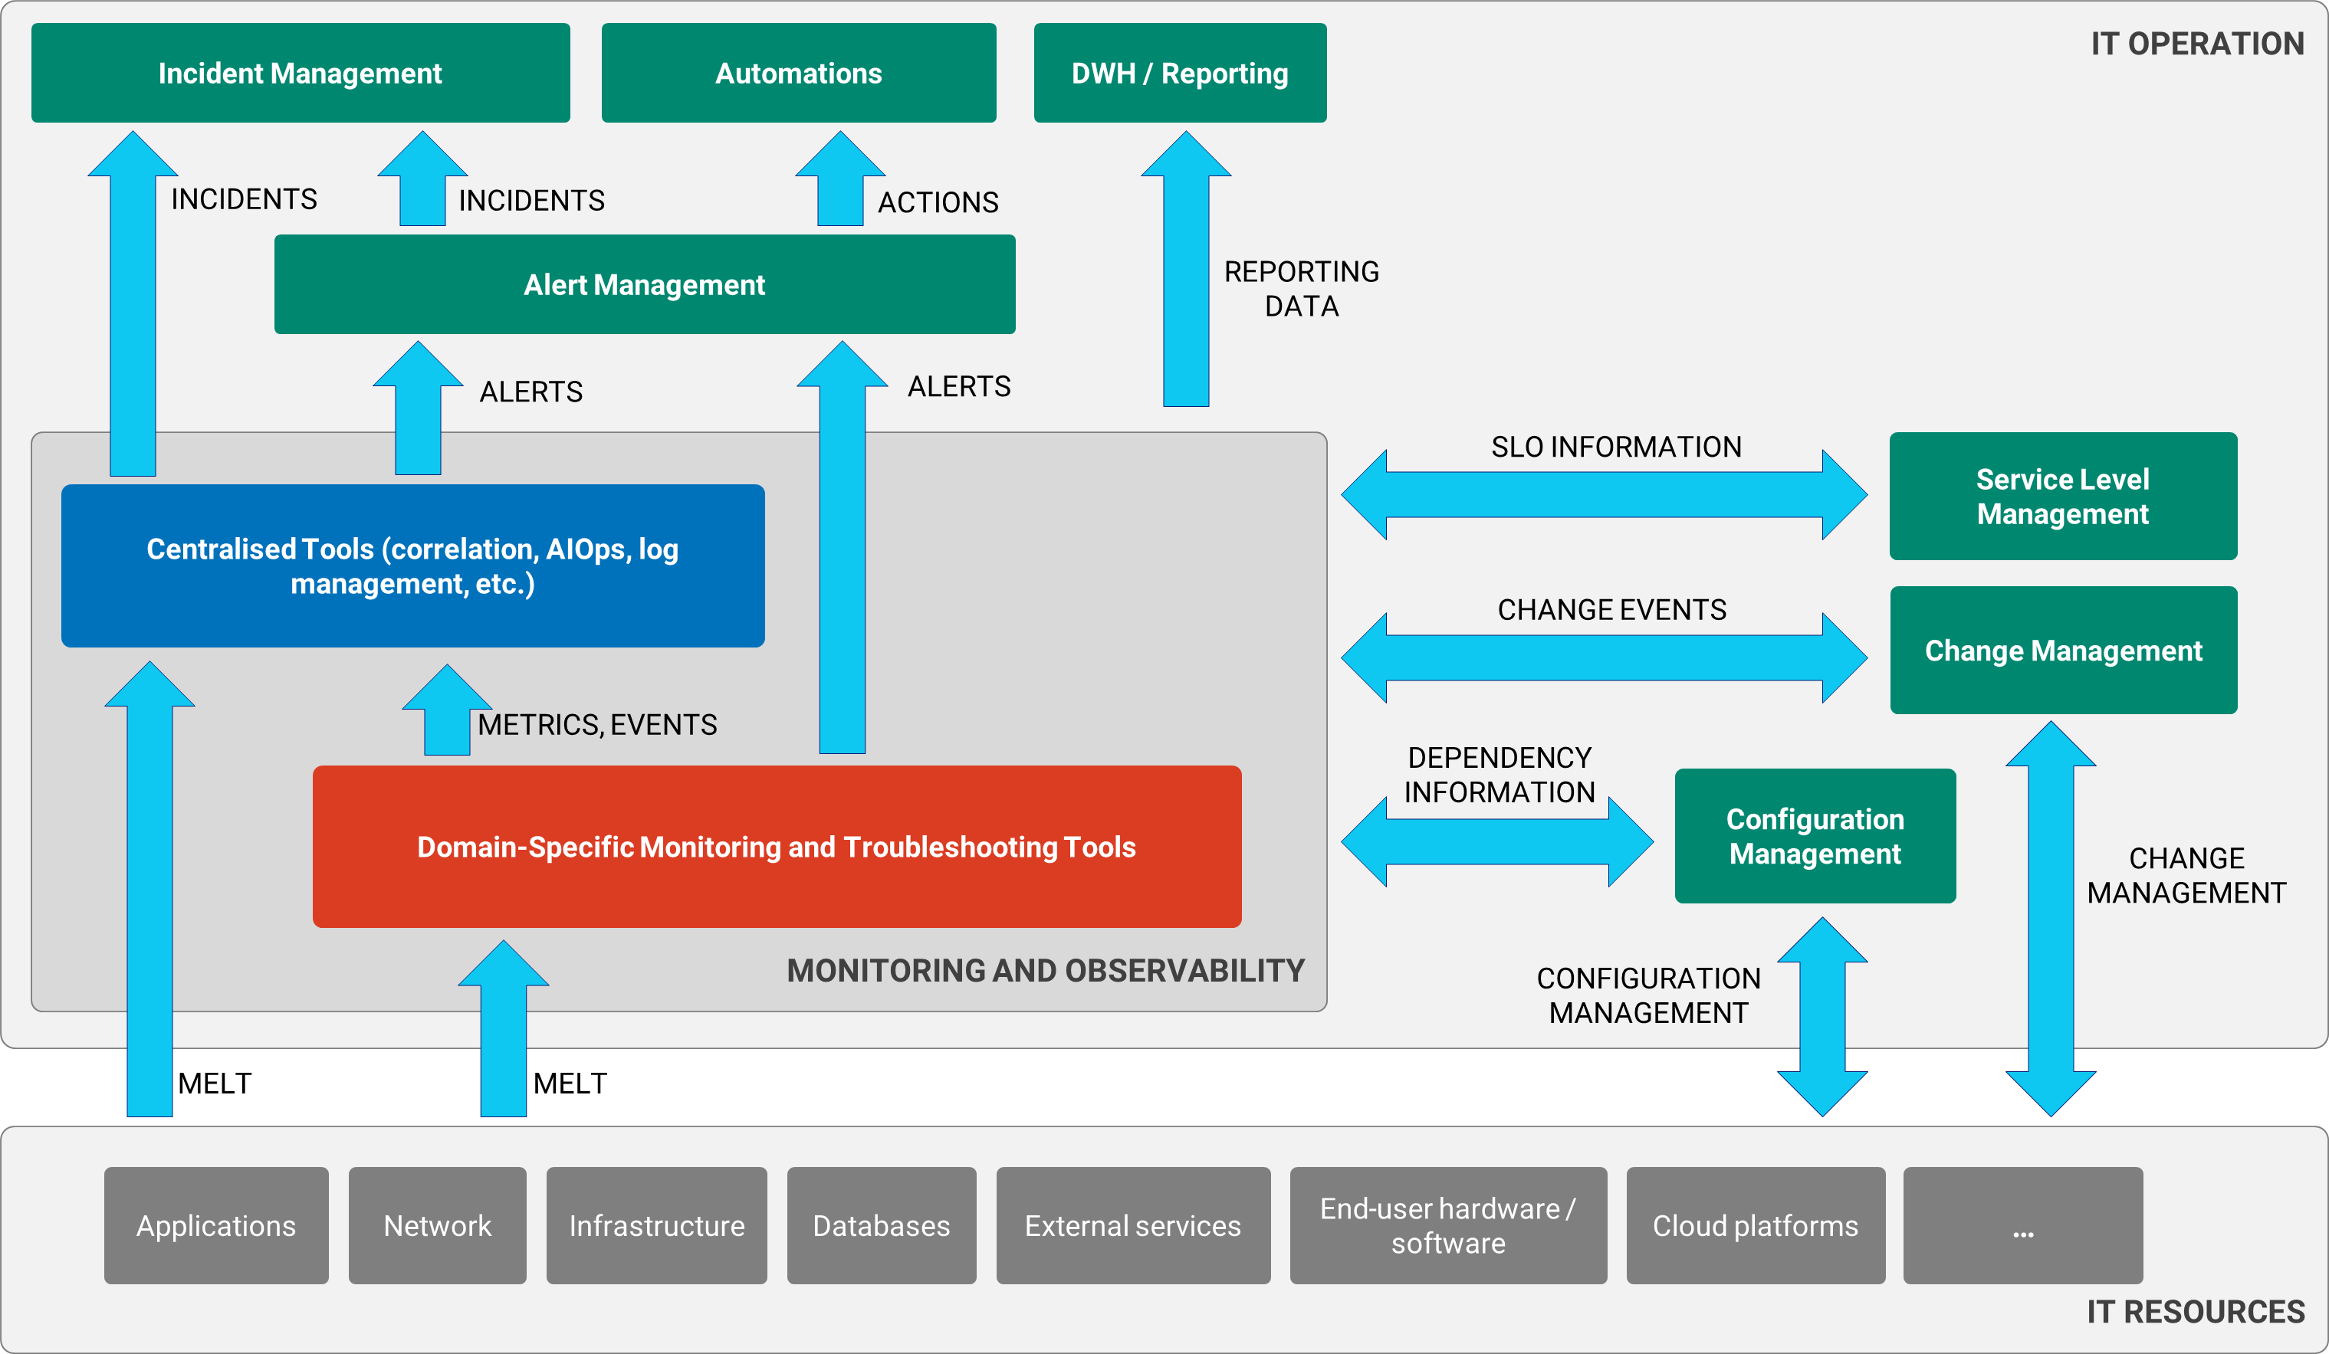
Appendix 3 – Observability reference architecture

